Slide 1

OPERATING SYSTEMS
File System

Slide 2
File Concept
A file is a named collection of related information that is recorded on secondary storage such as magnetic disks, magnetic tapes and optical disks.
In general, a file is a sequence of bits, bytes, lines or records whose meaning is defined by the files creator and user.
Contiguous logical address space
Types:
  Data
    numeric
    character
    binary
  Program
Contents defined by file’s creator
  Many types
    Consider text file, source file, executable file

Slide 3
File Attributes
Name – only information kept in human-readable form
Identifier – Along with the name, Each File has its own extension which identifies the type of the file. For example, a text file has the extension .txt, A video file can have the extension .mp4.
Type – needed for systems that support different types
Location – pointer to file location on device
Size – current file size
Protection – controls who can do reading, writing, executing
Time, date, and user identification – data for protection, security, and usage monitoring
Information about files are kept in the directory structure, which is maintained on the disk

Slide 4
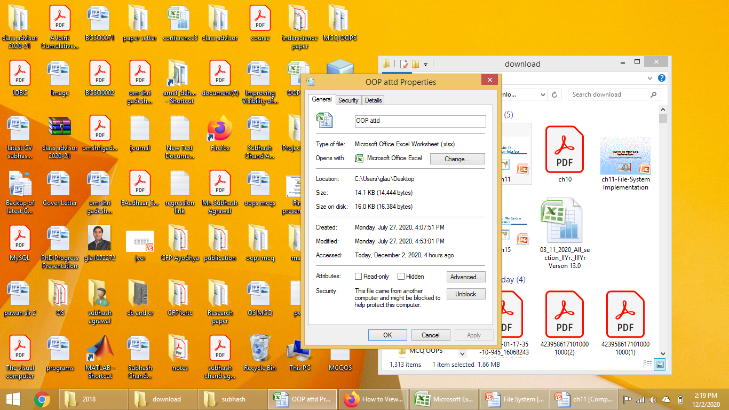

File info Window on Windows

Slide 5
File Operations
File is an abstract data type
Create
Write – at write pointer location
Read – at read pointer location
Reposition within file - seek
Delete
Truncate
Open(F_{i}) – search the directory structure on disk for entry F_{i}, and move the content of entry to memory
Close (F_{i}) – move the content of entry F_{i} in memory to directory structure on disk

Slide 6

File Types – Name, Extension

Slide 7
Access Methods
Sequential access
Direct/Random access
Indexed sequential access

Slide 8

Sequential-access File
A sequential access is that in which the records are accessed in some sequence, i.e., the information in the file is processed in order, one record after the other.
This access method is the most primitive one.
Example: Compilers usually access files in this fashion.

Slide 9
Direct/Random access
Random access file organization provides, accessing the records directly.
Each record has its own address on the file with by the help of which it can be directly accessed for reading or writing.
The records need not be in any sequence within the file and they need not be in adjacent locations on the storage medium.
The Direct Access is mostly required in the case of database systems

Slide 10
Indexed sequential access
This mechanism is built up on base of sequential access.
An index is created for each file which contains pointers to various blocks.
Index is searched sequentially and its pointer is used to access the file directly.

Slide 11

Simulation of Sequential Access on Direct-access File

Slide 12
Other Access Methods
General involve creation of an index for the file
Keep index in memory for fast determination of location of data to be operated on
A particular record can be accessed by its index.
The index is nothing but the address of a record in the file.

Slide 13

Example of Index and Relative Files

Slide 14
Directory Structure
A collection of nodes containing information about all files
Directory
Files
F 1
F 2
F 3
F 4
F n
Both the directory structure and the files reside on disk

Slide 15
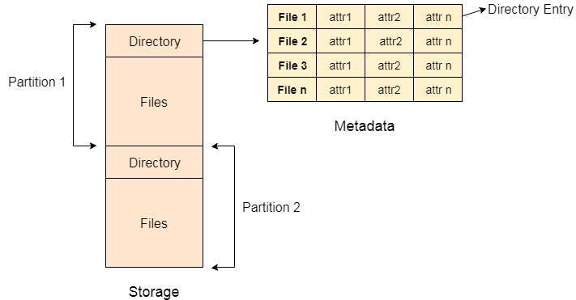

Slide 16
Operations Performed on Directory
Search for a file
Create a file
Delete a file
List a directory
Rename a file
Traverse the file system

Slide 17
Directory Organization
The directory is organized logically to obtain
Efficiency – locating a file quickly
Naming – convenient to users
  Two users can have same name for different files
  The same file can have several different names
Grouping – logical grouping of files by properties, (e.g., all Java programs, all games, …)

Slide 18
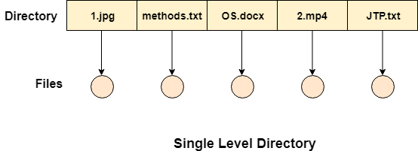
Single-Level Directory
A single directory for all users
implementation is very simple.
If the sizes of the files are very small then the searching becomes faster.
File creation, searching, deletion is very simple since we have only one directory.

Slide 19
Disadvantages
We cannot have two files with the same name.
The directory may be very big therefore searching for a file may take so much time.
Protection cannot be implemented for multiple users.
There are no ways to group same kind of files.
Choosing the unique name for every file is a bit complex and limits the number of files in the system because most of the Operating System limits the number of characters used to construct the file name.

Slide 20

Two-Level Directory
Separate directory for each user
Path name
Can have the same file name for different user
Efficient searching
No grouping capability

Slide 21

Tree-Structured Directories
In Tree structured directory system, any directory entry can either be a file or sub directory.
Tree structured directory system overcomes the drawbacks of two level directory system.
The similar kind of files can now be grouped in one directory.

Slide 22

Acyclic-Graph Directories
In this system, two or more directory entry can point to the same file or sub directory.

